Slide 1
Study on Improving School and Family Communication and Engagement: Lessons from Remote Schooling during the Pandemic
Sarah Duncan
UChicago Network for College Success
Vanessa Gutierrez
David Orta
The University of Chicago Consortium on School Research
Council of the Great City Schools
Public Relations Executive Meeting
July 15, 2022
Notes:
Acknowledge the Lewis Sebring Foundation + Funders?
Thank Jon Brooks, our research assistant for helping us with creating this powerpoint

Slide 2
Agenda
PART 1: April 2022 report brief
Study Background
Findings:
Lessons during remote learning
Three Engagement Approaches
Q & A
PART 2: Educator Discussion Guide
Notes:
Disclaimer about parents:

Slide 3
Share with a partner
Turn to the people near you. In groups of 2 or 3, each person should take a minute to talk about the following:
In your work, what recent communication practice with parents have you been most proud of?

Slide 4
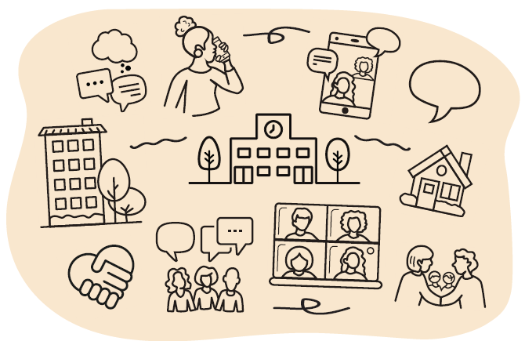
Improving School and Family Communication and Engagement: Lessons from Remote Schooling during the Pandemic
Notes:
We refer to “parents” here, and intend to be inclusive of all family members.
The parent focus groups we refer to throughout this brief included a wide range of caregivers, family members, and guardians
who supported students during remote schooling. Because of this, we often use the term “caregiver.” Where we do use “parent,”
we consider it a broad definition that includes the full breadth of people who cared for and supported students. Additionally,
sometimes we use the term “family” to refer to the rich home life that encompasses students’ worlds.

Slide 5
Study: Guiding Question
What can we learn about promising practices in teacher and family communication during remote schooling and COVID-19?

Slide 6
Our Research Partners
Kids First Chicago
The Middle Grades Network of the To&Through Project
The Network for College Success
Stand for Children Illinois
University of Chicago Urban Teachers Education Program
The Office of Family and Community Engagement (CPS)
The Office of Language and Cultural Education (CPS)

Slide 7
Communication lessons from remote schooling
Day-to-day teacher communication practices
Programmatic, school-wide practices

Slide 8
Day-to-day teacher communication practices
Virtual meeting options provided more flexible scheduling opportunities for parents to communicate with educators
Mobile apps increased timely communication between parents and educators
Translation features in mobile apps allowed for direct communication between educators and parents who speak languages other than English

Slide 9
School-wide practices
Schools enlisted all staff members, including non-instructional staff, to serve as additional resources to help cultivate additional relationships between schools and parents
Schools created inclusive, family-focused co-curricular events that helped deepen their relationships with parents
Schools created virtual and in-person forums where parents connected with one another and deepened their sense of community
Understanding students’ family and community contexts helped schools to reach – and know how to be reached by – families during the pandemic
Notes:
4. Schools enlisted all staff members, including non-instructional staff, to serve as additional resources to help cultivate additional relationships between schools and families
In one example, we saw how parents learned about information regarding the distribution of devices and internet hotspots through the security guard. They appreciated this.
Moving forward, expanding the role of communicating with caregivers to include additional staff may serve to foster additional ties with families and make more parents feel connected to their children’s school.
5. Schools created inclusive, family-focused co-curricular events that helped deepen their relationships with caregivers
We had some examples of, even in a virtual setting, schools and teachers put together online family events that promoted communication, engagement with students - still learning focused - but also inclusive of families.
Holding events that are non-evaluative, where students will not be held accountable for parent participation, would benefit school and family communication because they would be intentionally focusing on relationship building.
6. Schools created virtual and in-person forums where caregivers connected with one another and deepened their sense of community
Along the same lines, parents and caregivers, especially during difficult moments of the pandemic, appreciated the chance to build community with other parents and caregivers at their school. Continuing this practice would allow them to feel more supported and a part of a school community.
7. Understanding students’ family and community contexts helped schools to reach – and know how to be reached by – families during the pandemic
Finally, we saw a good number of examples across focus groups that suggested that when educators held a knowledge of the families in the school, fluency in the language, and/or shared common backgrounds in neighborhood or culture, communication was facilitated and embraced more readily.
Some examples included, when parents talked about how their world lights up when their childrens’ teachers shared culture, or when educators observed that they often became de-facto school contacts for families because they were known to have connections to the neighborhood and school.
This is an area of investment that predates the pandemic, diversifying the educator staff and providing culturally-relevant training appears to be an important opportunity area for schools.

Slide 10
A key challenge:
My principal’s very supportive, however, if we're speaking specifically in the area of communication [with families]. Nothing. I am on my own. All year -- in terms of communication... I've been pretty much on my own. [The principal] says, ‘Here's a spreadsheet, but it wasn't meaningful. It didn't come with any guidance on how we should be communicating with parents or what to do if certain communications are ineffective or how to communicate about some of the common problems we're seeing as a school.
- Elementary School Teacher
Teachers needed additional support and guidance in understanding the purpose of communication
Notes:
A core challenge emerged as a theme in our focus groups.
Educators identified a need for additional support.
As illustrated in this quote:
While they were doing outreach and communicating with parents, employing their own practices in doing this, it was hindered by a lack of support and guidance from leadership about the purpose, and intent behind engaging parents.

Slide 11
Applying an intentional lens to school - family engagement approaches

Slide 12
You can follow along with us!
Please take out both handouts (findings + discussion guide).
As we describe each of these approaches, think about whether your practices fall in any of these three categories.
You can use your own notes or the space allotted in the discussion guide.

Slide 13
Describing Three Engagement Approaches
Engagement Approach | Dimensions
Traditional parent involvement School-parent Partnership Family and Community Centered | School’s relationships with families Intention and goals Decision-making structure Communication with parents

Slide 14
Engagement Approach #1: Traditional parent involvement
School’s Relationship with Families | Intentions and Goals | Decision-Making Structure | Communication with Parents
Schools assume responsibility for children and youth at school, and assign responsibility for them at home. There is a clear division of roles and responsibilities School and family are each independent—considered separate spheres. | To help parents develop at-home behaviors that will lead to improved student academic performance. | Schools make most decisions independently, without the input of families and with limited attention to the perspectives and experiences of parents. | Communication is limited and one-way, and is typically about academic performance and scholastic events.

Slide 15
Engagement approach #2: School-parent partnership
School’s Relationship with Families | Intentions and Goals | Decision-Making Structure | Communication with Parents
School routinely solicits feedback from parents. Parent perspective is collected often. | To improve student academic achievement. May also aim to improve parent involvement levels across the school. | Schools consult with parents, gathering input to make selected decisions. The values and opinions of parents have some influence in school matters. | Communication is two-way, with parent feedback focused on selected topics, often initiated by the school.

Slide 16
Engagement approach #3: Family and Community Centered
School’s Relationship with Families | Intentions and Goals | Decision-Making Structure | Communication with Parents
Schools facilitate the leadership of parents by providing space and welcoming their participation in influential school decisions. | To create a community within the school that collaborates to arrive at shared goals. To promote the overall well-being of students and their families. | Schools share decision-making responsibility with parents. Community perspective is taken into account for a range of concerns. The school’s goals and strategies are decided upon collectively. | Communication is two-way, with conversations that address a wide range of topics, including out-of-school needs and experience.

Slide 17
Clarifying Questions?
Notes:
Questions

Slide 18
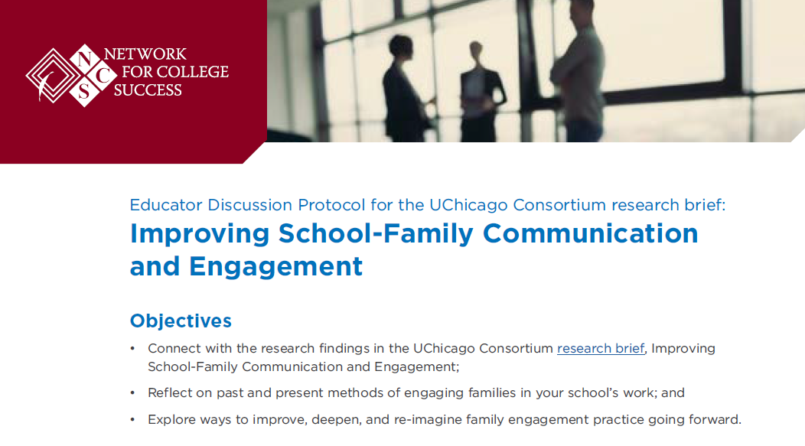
Part 2: NCS Educator Discussion Protocol
Notes:
Participants will have a print out, Sarah will facilitate.

Slide 19
Closing Thoughts
Leaders can guide practice around family engagement by providing additional professional development opportunities for teachers, and creating a clear set of norms and expectations for staff.
If relationships between schools and families are to be strengthened, it is important that schools develop coordinated and cohesive strategies at a school-wide level.

Slide 20
consortium.uchicago.edu
consortium.uchicago.edu
ncs.uchicago.edu
THANK YOU!

